Slide 1
Web Scraping and Crawling in Ruby and JS
Adina Bianchi

Slide 2
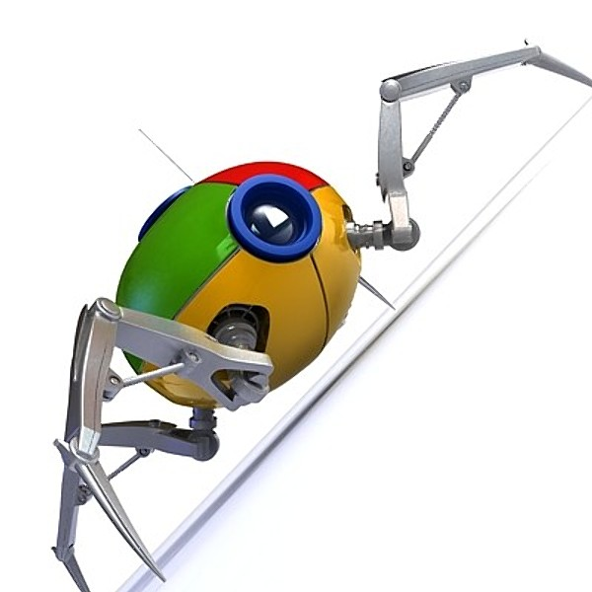
> Considerations
Why?
Legal concerns
Which tools?
> Methods
Scraping
Crawling
> Tools
Nokogiri
Mechanize
Cheerio
PhantomJS/CasperJS

Slide 3
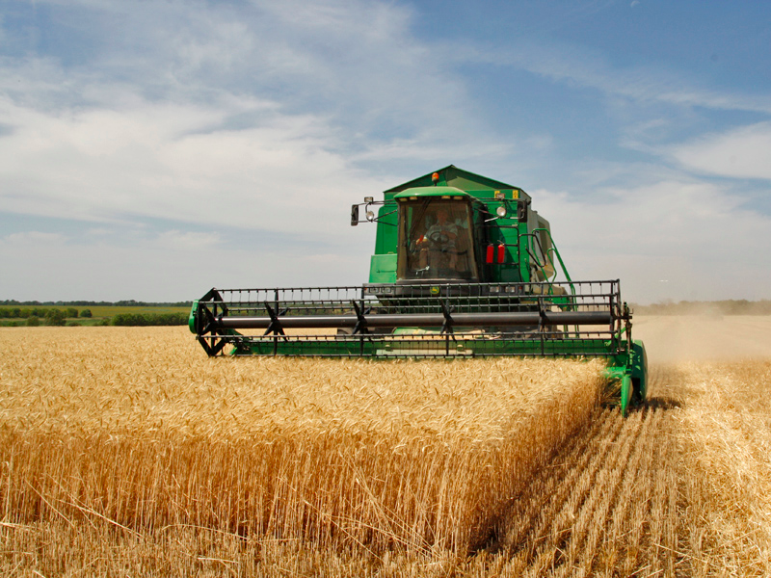
Why?
Harvest data with no API
Automate tasks
Testing
Notes:
Web scraping- creating an api where there is none

Slide 4

Considerations
Mind your Robots
.txt
Considerations:
robots.txt
Don’t be greedy
Don’t steal
Scrapers are more brittle than APIs
Notes:
Don’t steal unless you’re doing it for good reasons
Don’t accidentally do a denial of service attack on your favorite website

Slide 5
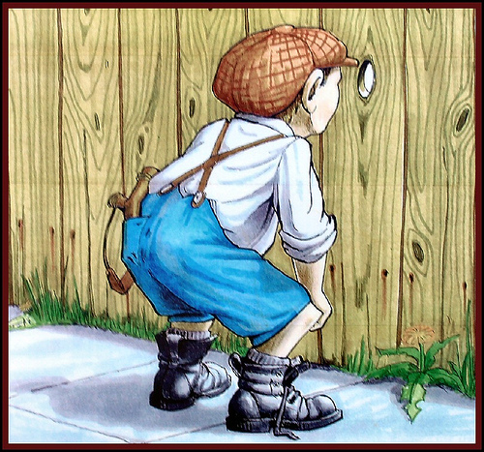
Snoop first
Look for an API!
Look for useful params
Pull down HTML
Parse
Do stuff
Notes:
Just because there’s no publically documented api doesn’t mean there isn’t a publically accessible one

Slide 6

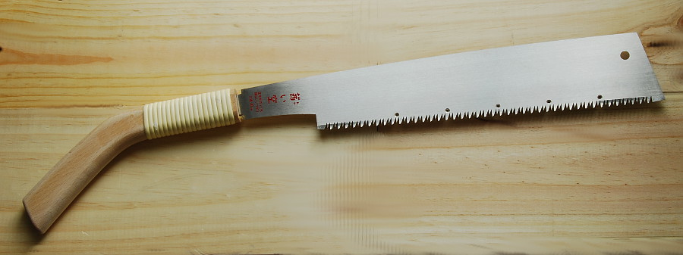

Slide 7

Mechanize
Notes:
The Mechanize library is used for automating interaction with websites. Mechanize automatically stores and sends cookies, follows redirects, and can follow links and submit forms. Form fields can be populated and submitted. Mechanize also keeps track of the sites that you have visited as a history.
upload/download files
No javascript engine

Slide 8

Web Crawling
Scrape dynamic sites
Javascript Support
Interact with page using headless browser

Slide 9

Headless Browsers
Notes:
Can’t detect except via request rate, pattern behavior, captchas

Slide 10

Cheerio

Slide 11
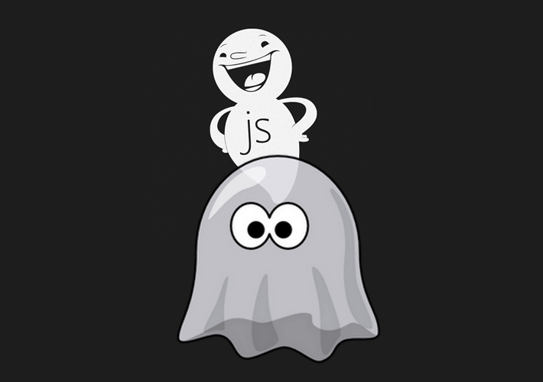
Phantomjs + Casperjs
Notes:
Phantom - scripted, headless browser used for automating web page interaction. Used for unit testing
Casper - API and test framework on top of phantom. Provides clicking, waiting, form submissions, assertions, screenshots

Slide 12
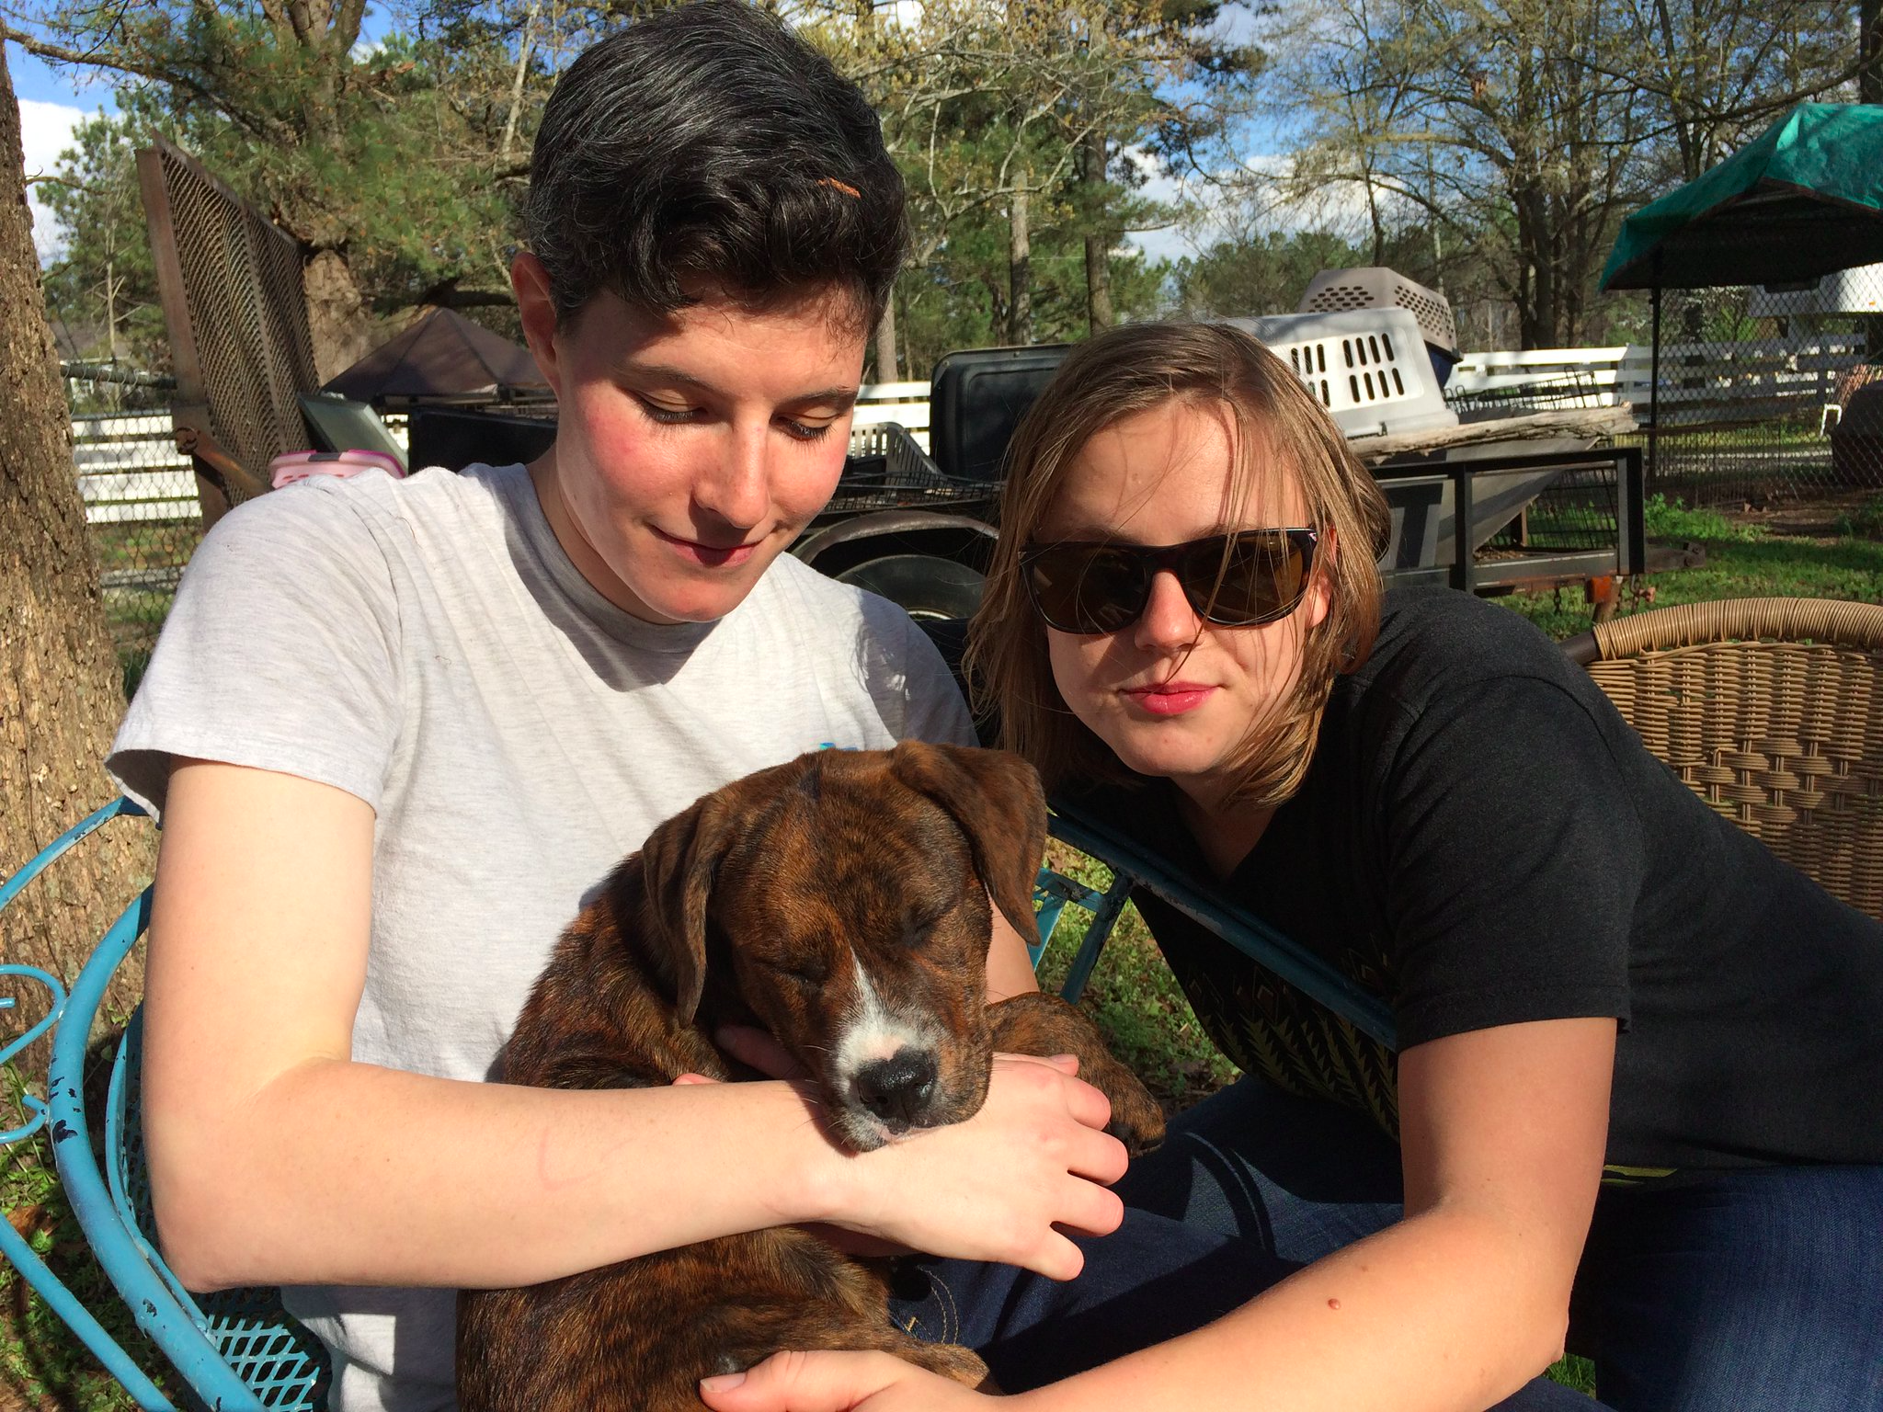
TIYDurham @adina
TriangleDevs @arbianchi
acuriousloop@gmail.com
github.com/arbianchi/WebscrapingTalk

